Slide 1
PROJECT TITLE
Smart Maintenance: Predicting Machine Failures Using AI (Predictive Maintenance of Industrial Machinery)
Presented By:
Sri Kumar Muppidi – Malla Reddy College Of Engineering-CSE-DS
Github repository link:- https://github.com/Srikumarsk/IBM-Final-project/tree/main

Slide 2
OUTLINE
Problem Statement
Proposed System/Solution
System Development Approach (Technology Used)
Algorithm & Deployment
Result (Output Image)
Conclusion
Future Scope
References

Slide 3
Problem Statement
In today’s industrial environment, unexpected machine breakdowns can cause serious disruptions, leading to costly downtime and delays. Often, maintenance is done only after a problem occurs, which means issues like tool wear, overheating, or power faults aren’t caught early. This reactive approach not only wastes resources but also affects overall efficiency. There’s a growing need for a smarter system that can monitor machines in real time, understand patterns in sensor data, and predict failures before they happen—helping industries take action before it’s too late.

Slide 4
Proposed Solution
The system is designed to predict machinery failures in advance using machine learning and cloud deployment.
Dataset Source:
The predictive model is trained on the publicly available Kaggle Predictive Maintenance dataset, which includes real-world sensor data.
Data Collection & Preprocessing:
Use historical sensor readings such as air temperature, process temperature, rotational speed, torque, and tool wear.
Clean the data, handle missing values, and perform feature scaling and encoding.
Model Development:
Train a classification model (Random Forest) to detect and classify machine failure types.
Deployment Platform:
The entire system is developed and deployed on IBM Cloud Lite using IBM Watson Studio for model training, evaluation, and serving.
Output:
Real-time prediction of machine failure types to enable timely maintenance decisions.

Slide 5
System Approach
System Requirements:
Sensor data (temperature, vibration, etc.)
IBM Cloud Lite environment
Libraries/Tools Required:
IBM Watsonx.ai Studio
Runtime

Slide 6
Algorithm & Deployment
Algorithm Selection:
Random Forest / XGBoost / SVM for failure classification
Data Input:
Real-time operational data (air temperature, process temperature, torque, tool wear, etc.)
Training Process:
Dataset split into training and test sets
Feature scaling and encoding
Hyperparameter tuning via cross-validation
Deployment:
Trained model is deployed on IBM Cloud as an API
Real-time data can be passed for predictions

Slide 7
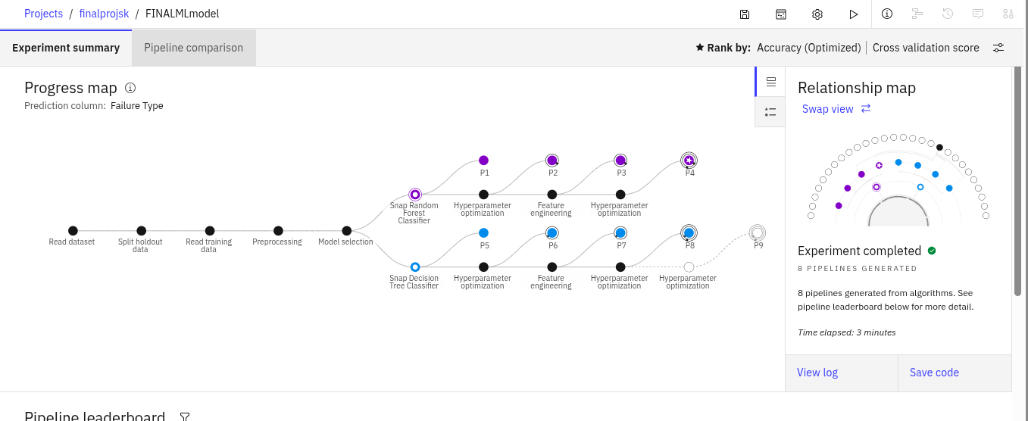
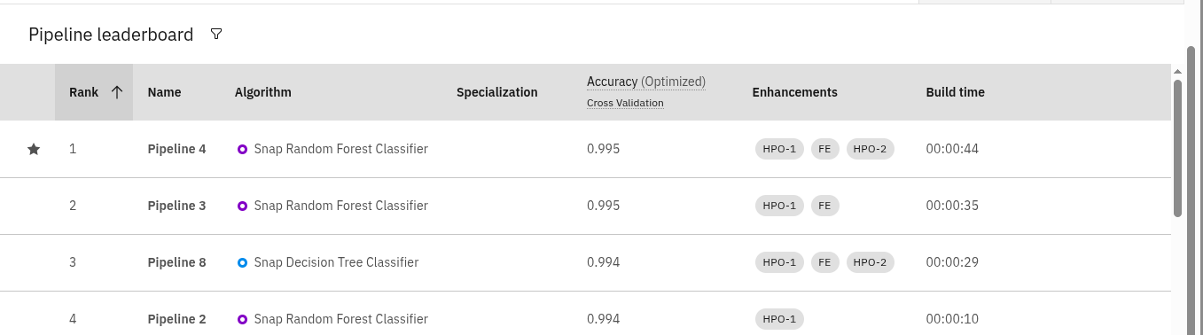
Result

Slide 8
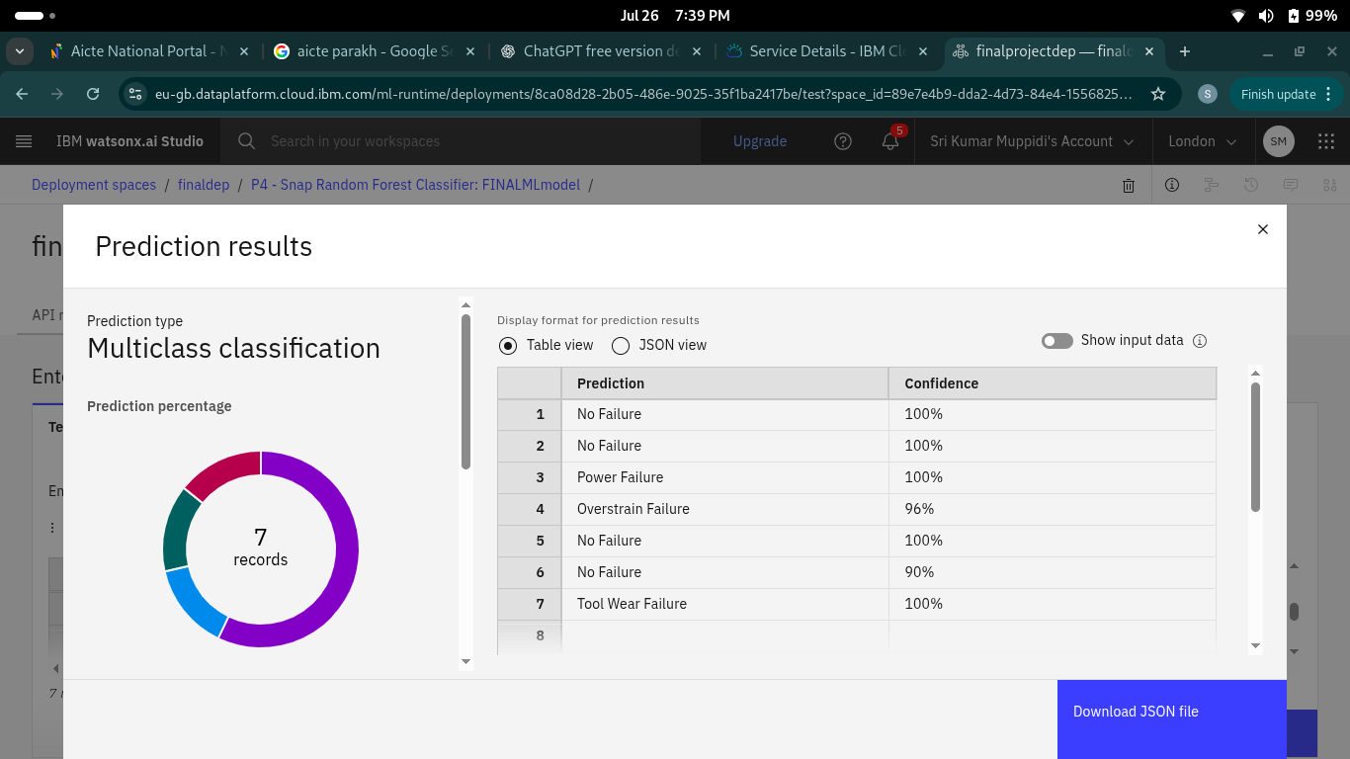
Result

Slide 9
Conclusion
The predictive maintenance model effectively anticipates equipment failures, allowing timely interventions. This leads to:
Reduced machine downtime
Lower maintenance costs
Enhanced production efficiency
Github Repository Link:- https://github.com/Srikumarsk/IBM-Final-project/tree/main

Slide 10
Future scope
Integrate deep learning models (e.g., LSTM) for time-series sensor data
Extend the system to include more types of equipment
Integrate with IoT platforms for automated alerts
Improve model with live feedback loop from the factory floor.

Slide 11
References
https://www.kaggle.com/datasets/shivamb/machine-predictive-maintenance-classification
IBM Cloud Documentation

Slide 12
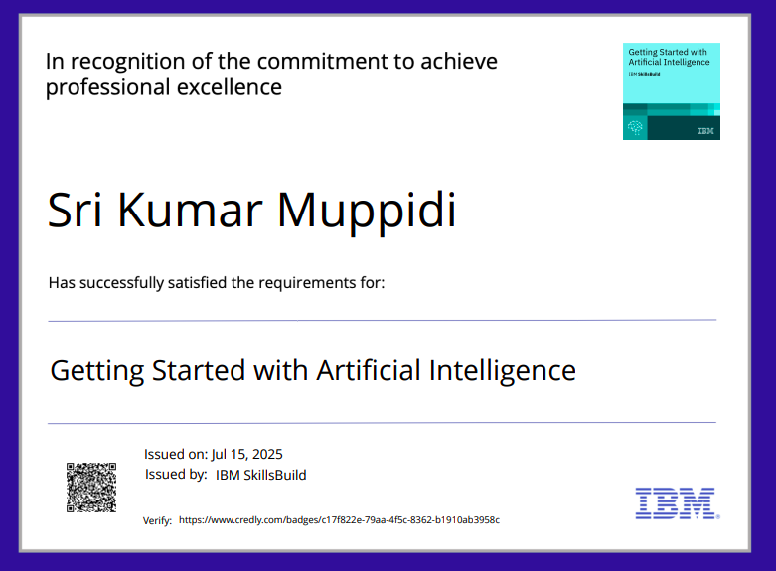
IBM Certifications
Screenshot/ credly certificate( getting started with ai)

Slide 13
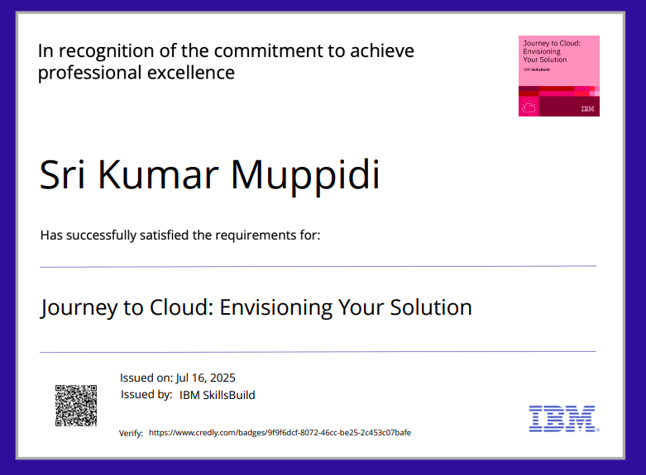
IBM Certifications
Screenshot/ credly certificate( Journey to Cloud)

Slide 14
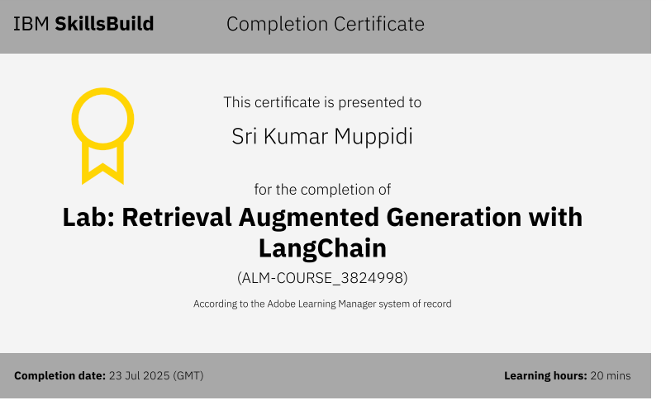
IBM Certifications
Screenshot/ credly certificate( RAG Lab)

Slide 15
THANK YOU

